Slide 1
GrowMart
Done By: Team Sankalp
Mentor: Suraj mourya
Team Members:
- Koushik Yadav
- Jyanesh Naidu
- Manish kashyap
- yuvaraj

Slide 2
Problem Statement
• Small-scale shopkeepers struggle to expand beyond local markets.
• Lack of digital presence, inventory insights, and nationwide reach.
• Existing solutions are fragmented with no unified growth platform.
• Stakeholders: Shopkeepers, Customers, Logistics Partners.
• Impact: Empower 60M+ small businesses in India with digital growth.

Slide 3
Objectives & Success Metrics
Objectives:
• Provide shopkeepers with a nationwide selling platform.
• AI-driven insights: market prices, trending items, profit/loss analysis.
• Real-time inventory + logistics guidance.
Success Metrics:
• ≥75% accurate demand forecasting.
• ≥90% uptime for inventory updates.
• ≤2 sec response time for AI recommendations.

Slide 4
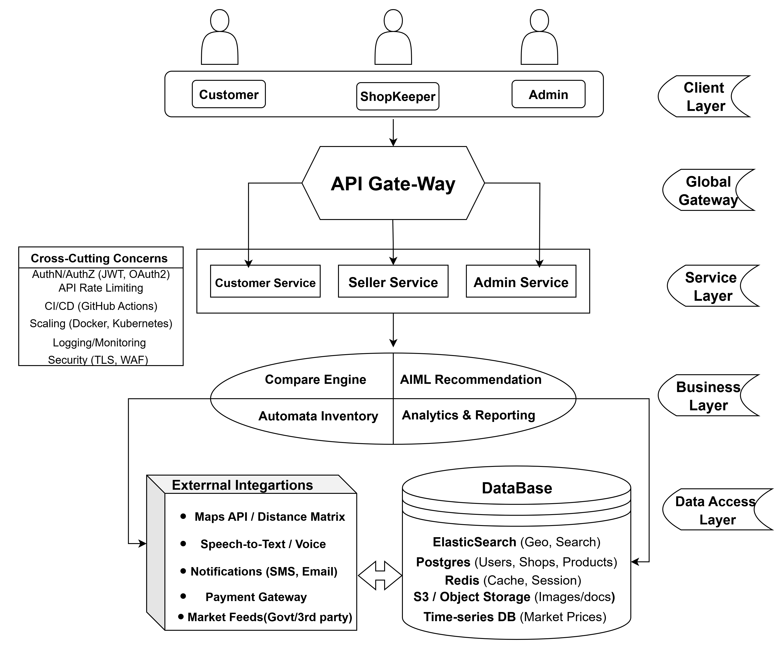
System
Architecture

Slide 5
Comparison of Technologies
Java (Spring Boot Backend):
Pros: Secure and strong ecosystem for APIs.
Cons: Bit complex development cycle compared to lightweight frameworks → ✔️ Chosen
React.js(Frontend):
Pros: Modern UI, reusable components and strong community support.
Cons: Requires extra libraires for state management( Redux, Context API) → ✔️ Chosen
Python(TensorFlow/Scikit-learn):
Pros: Excellent AI/ML ecosystem, wide range of prebuilt models.
Cons: Needs integration bridge(Rest API/ Java –python connector) →✔️ Chosen

Slide 6
Model Comparison Plan
Models Tested by us are:
• Demand Forecasting → ARIMA and LSTM
• Recommendation System → Collaborative Filtering and Neural Network
Decision taken: LSTM + Neural Net (better accuracy for trends) .

Slide 7
Risks & Assumptions
• Poor dataset quality → Mitigation: Use government & open-market datasets.
• Shopkeepers’ low tech adoption → Mitigation: Mobile-first UI with OTP login.
• Logistics challenges → Mitigation: Partner APIs for transport cost comparison.
Work Breakdown & Roles
• (Jyanesh/Yuvaraj)->AI/ML: Demand forecasting, recommendations.
• (Manish)->Backend: APIs for inventory, payments, logistics.
• Frontend->(Koushik): Web designing and UI management.

Slide 8
Timeline
• Week 1–2: Foundation Setup and Core Features - Shops & Products
• Week 3–4: Inventory & Notifications and AI Integration & Advanced Features
• Week 5: Testing & Deployment
References
Datasets: Government Open Market Data, Kaggle
Libraries: TensorFlow, Scikit-learn, PyTorch
Docs: Official APIs, Research Papers

